Slide 1

National Forum on Youth Violence Prevention
White House Office of National Drug Control Policy
ONDCP seeks to foster healthy individuals and safe communities by effectively leading the Nation’s effort to reduce drug use and its consequences.
Gil Kerlikowske, Director

Slide 2
“Above the Influence” Campaign
…Engaging Directly with Teens
National Youth Anti-Drug Media Campaign

Slide 3
What We’ll Cover Today
Drug Cost Implications for Local Communities
Understanding Teens Today
Overview of “Above the Influence” (ATI), Youth Brand
Making Above the Influence Relevant to Your Community
ATI Toolkit of Youth Activities
Local Community Engagement
Question and Answer
Notes:
Potential presenter: Gem

Slide 4
The Costs to the Community…
$40 billion
Estimated annual
health care costs due to substance abuse
50%
Of criminal offenders are dependent on drugs
$129 billion
Lost productivity costs
73% of the 17.8 million drug users are employed, leading to loss of $129B in productivity
1/3
Nearly 1/3 of State prisoners committed their crimes under the influence of drugs
Notes:
Potential presenter: Gem

Slide 5
The Costs to the Community…
8.3 million
8.3 million children lived with a parent who was dependent on or abused alcohol or drugs during the past year (NSDUH)
2x
Youths aged 12 to 17 who used an illicit drug in the past year were almost twice as likely to have engaged in a violent behavior as those who did not (49.8% vs. 26.6%)
More Active, Less Drug Use
Youth who participate in youth activities have lower rates of cigarette, alcohol, or illicit drug use than those who did not
Past year rates of drug use:
  No activities 18.3%
  7+ activities 6.8%
Age 21
If a teen avoids drug
use before the age of 21, he or she will likely never become an addict
Notes:
Potential presenter: Gem

Slide 6
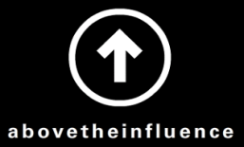
UNDERSTANDING TEENS TODAY

Slide 7
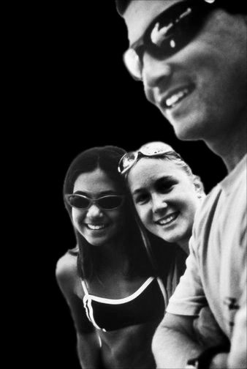
Teens Today
More connected, and connected to more
Pressure just being a teen
Influence is everywhere

Slide 8
Teens encounter substance-related content
84
times/day
Source: Nielsen

Slide 9
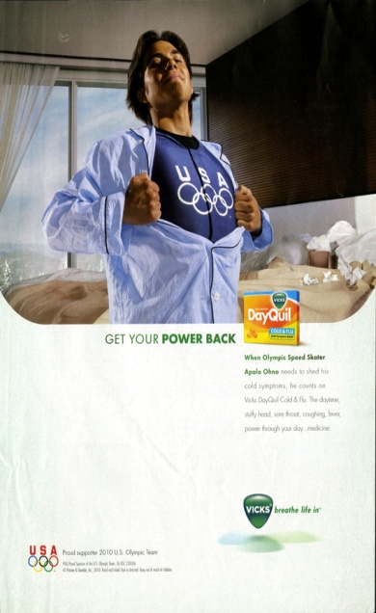
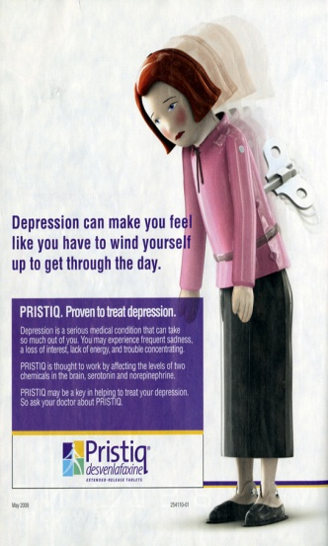
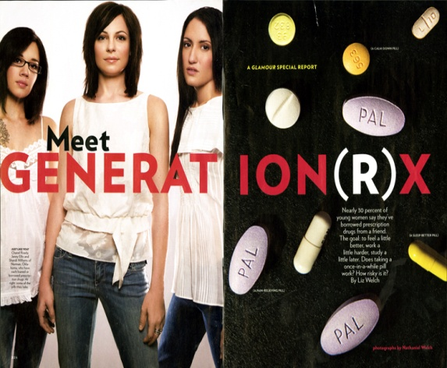
Negative Influences That
Spill To Teens in Ads
Teens 12–17 GRPs
45,000
40,000
35,000
30,000
25,000
20,000
15,000
10,000
5,000
0
FY2008
FY2009
ATI
Liquor
Beer
Pain Relievers
Prescription
Drugs
Source: Nielsen

Slide 10
79% of teens own a cell phone
Teen Girls receive
80
Texts/Day
Teen Boys only receive
30
Texts/Day
72% of teens use their cell phone to access the internet or consume other media

Slide 11
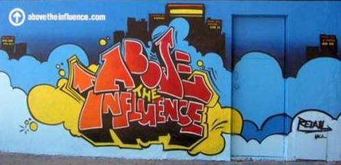
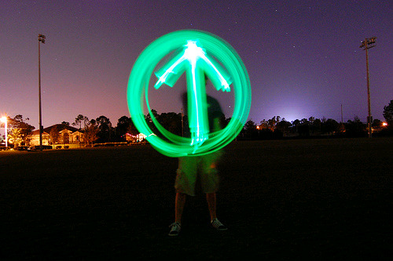


Above the Influence
6+ year brand investment (launched Nov 2005)
Targets teens ages 12-17
Brand philosophy:
  Inspires them to make smart choices
  Drugs/negative influences stand in the way of teens reaching their full potential
Evidence of effectiveness:
  Three independent research studies
  Youth tracking survey
  Youth exposed to ATI campaign are less likely to initiate/use
Notes:
Brand philosophy said another way: “You can choose to live your life under the influence of drugs and alcohol, or you can live above the influence of drugs and alcohol.”
Often-used brand descriptors: “from a teen’s voice,” “speaks to me,” “authentic,” “not preachy,” “not the scare tactic approach we always hear,” “inspirational,” and “aspirational”

Slide 12




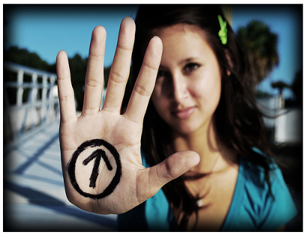




Above the Influence
Teens Know and See It
85% aware of Above the Influence advertising
Resonates Across Groups
>75% teens say Above the Influence speaks to someone like me
African American
Hispanic
White
Boys
Girls
=
Ad Awareness, OTX Research 2011
Addresses a Variety of Substances
Teens tell us Above the Influence could apply to everything — prescription drugs, alcohol and marijuana
Teens Making ATI Their Own
Notes:
All these indicators developed over the past 6 years told us we had built something powerful amongst teens
Taken together, they allowed us to re-launch in June 2010
With a new “multi-tiered” approach to address community partners’ desire to participate in ATI.
And with a broader messaging approach: addressing the general behavior of substance use, rather than focus on a singular substance, such as marijuana.

Slide 13
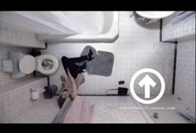
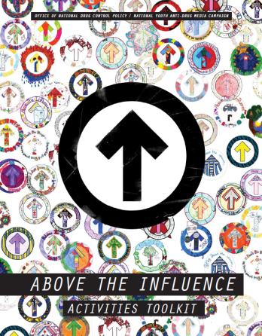

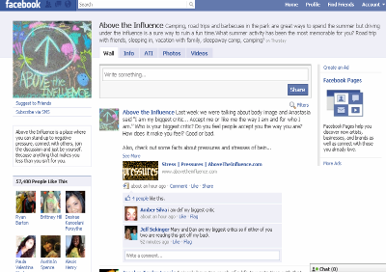
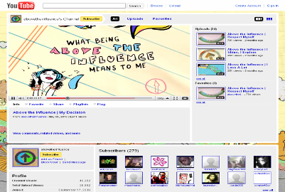









Above the Influence
National and Local
National Reach
Local Participation
>100 local partners in 50+ cities
Over a thousand
participants in conference
workshops and webinars.
Total Fans: 850,000+ fans
DRUG-FREE COMMUNITY GRANTEES
Broad National Messaging &
Strong Social Media Presence
“Above the Influence” Activities and Support for Local Community Organizations
Notes:
13

Slide 14
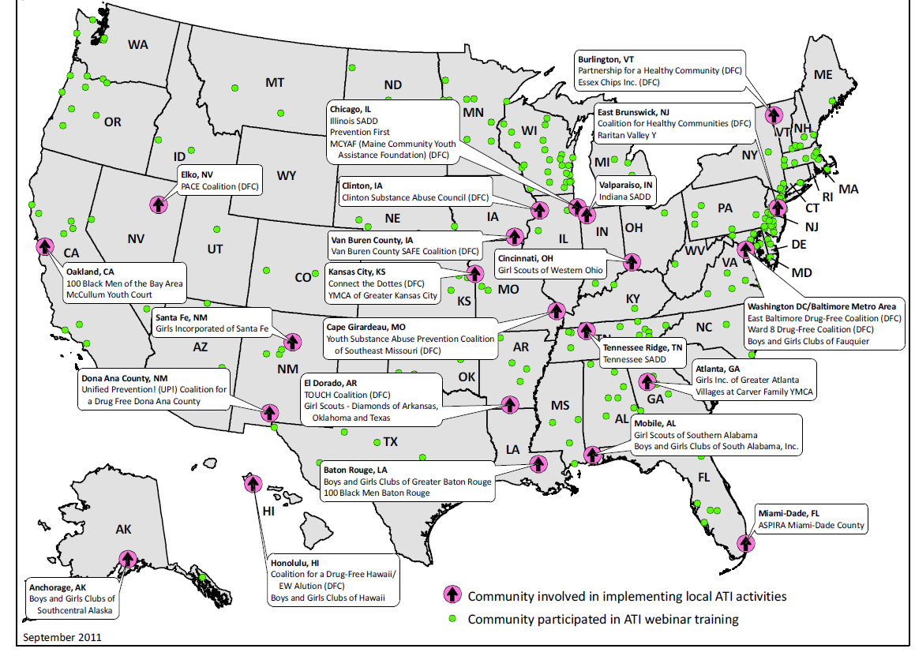
Above the Influence (ATI): Community Engagement (FY 2012)

Slide 15
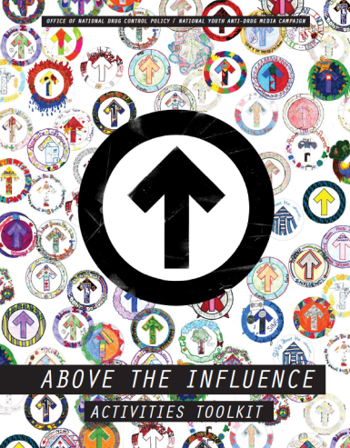
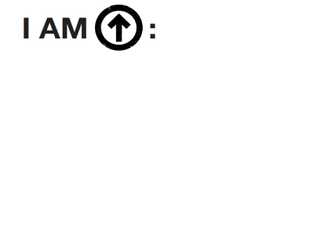

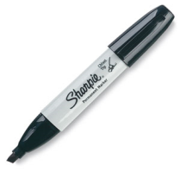
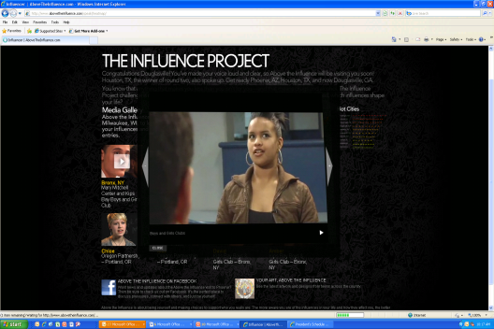
“Above the Influence” Toolkit
Instructions and templates on how to implement ATI Activities in local communities.
Current activities include:
  Influence videos & discussion guide
  Tag It
  ATI Art project
  Bring It
  Be It
  Express It
www.TheAntiDrug.com/resources
  “Tag It”
  Teen ATI Art
  Influence videos

Slide 16
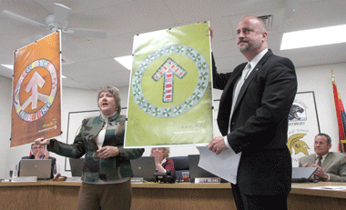
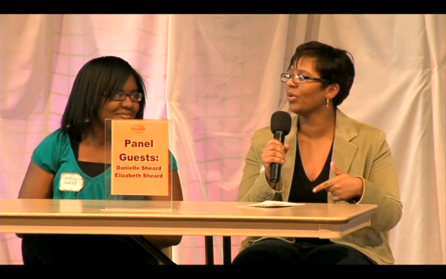
What We Hear From Partners
The ATI toolkit resources and activities have worked well with their existing programs.
They are able to use the ATI campaign as a valuable, nationally-recognizable asset that hits home with their teens… “kids want to be part of it”
A new way to engage kids in a discussion about drugs.

Slide 17
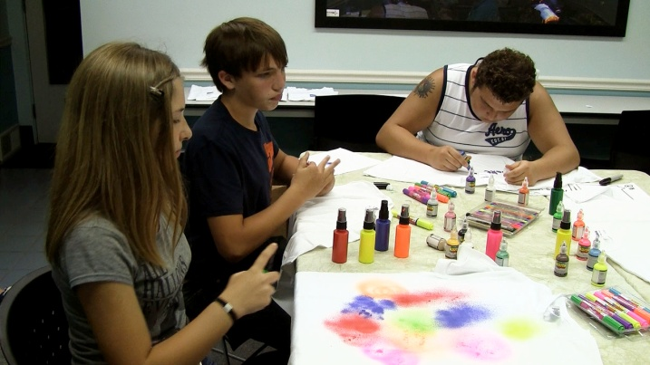
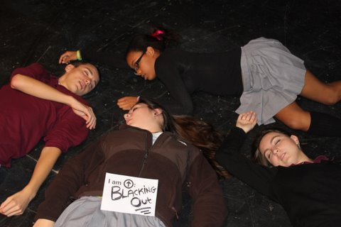
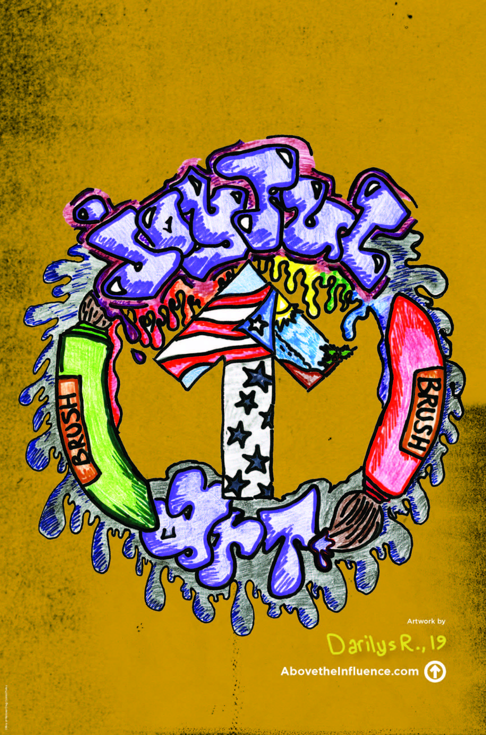
What We are Hearing from Teens
91 percent of teen participants favorably rate the ATI activities.
Teens’ perceptions of the risks associated with drug and alcohol use also increased after participating in ATI activities.
I am above
“Blacking Out.”
Darilys, 16

Slide 18
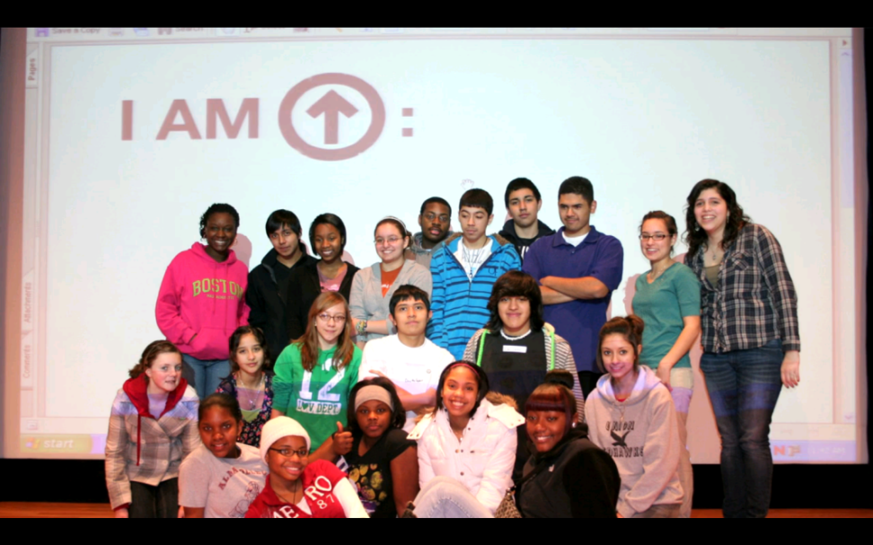
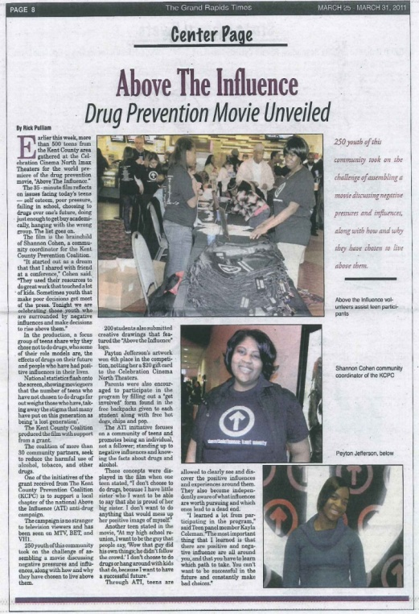
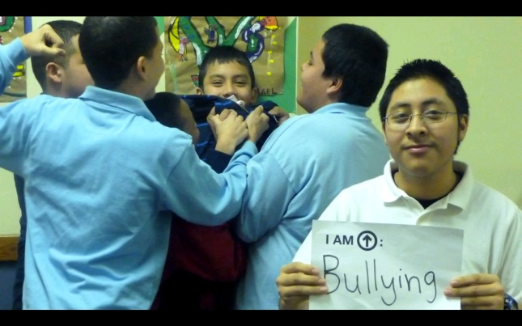
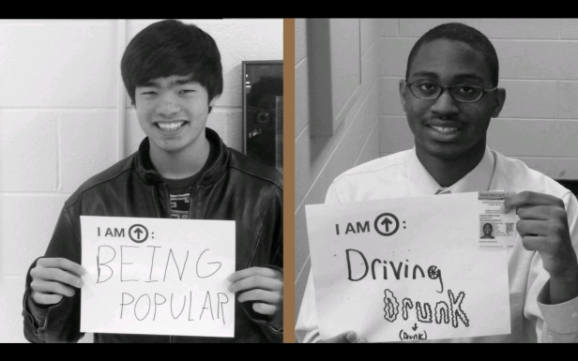
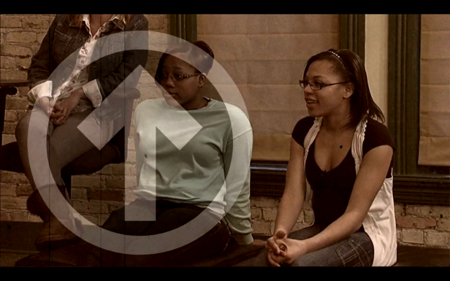
Kent County (MI) Prevention Coalition Video
Local Participation
On March 22, 2011, the Kent County Prevention Coalition (Grand Rapids, Michigan) premiered their teens’ 30-minute “Above the Influence: Kent County” movie at a local movie theater. Teens used the ATI Toolkit as a guide for the activities and discussions captured in the movie. The trailer is available online at http://vimeo.com/20308488.
I am above “Violence.”
I am above “”Being Popular” and “Driving Drunk.”

Slide 19
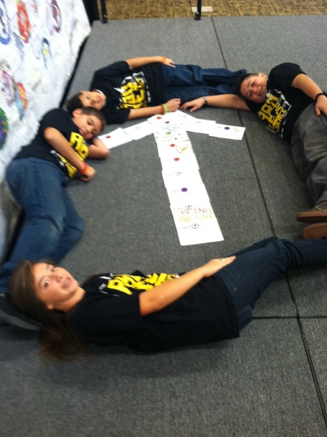
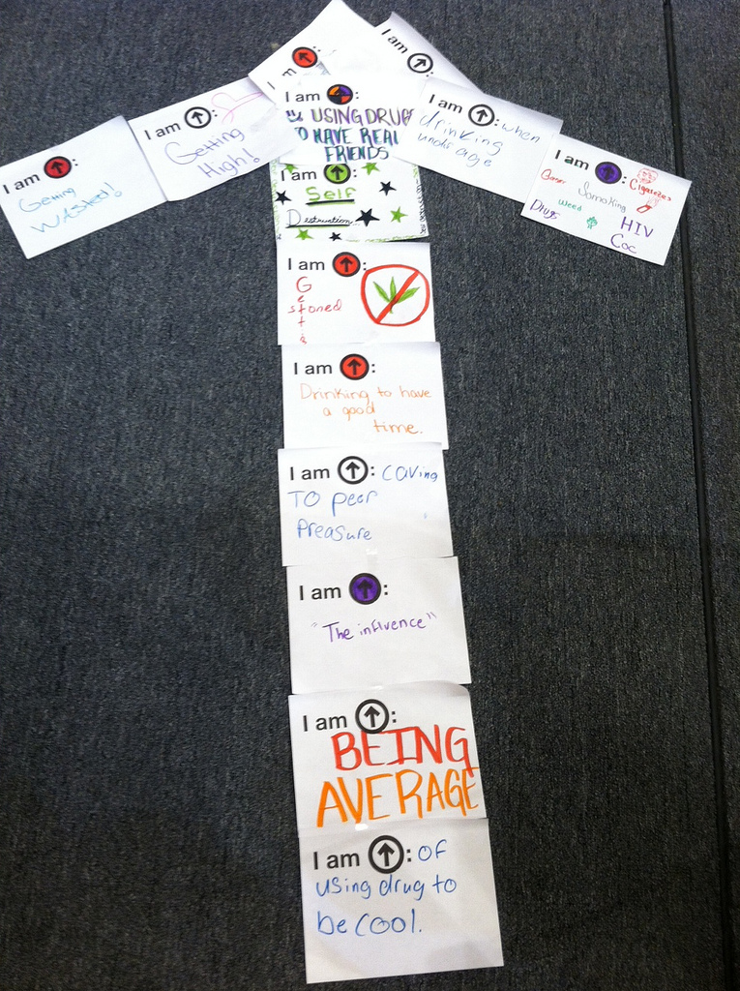
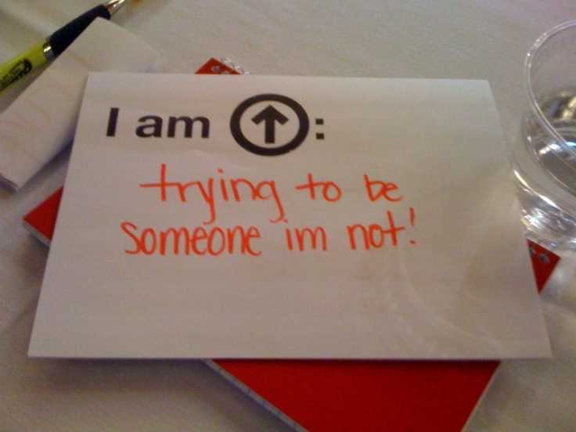
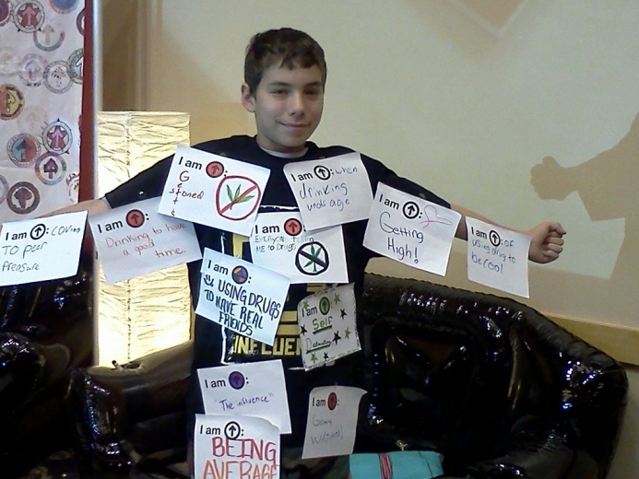
Tag It activity – Las Cruces, NM ATI Empowering Youth Conference

Slide 20
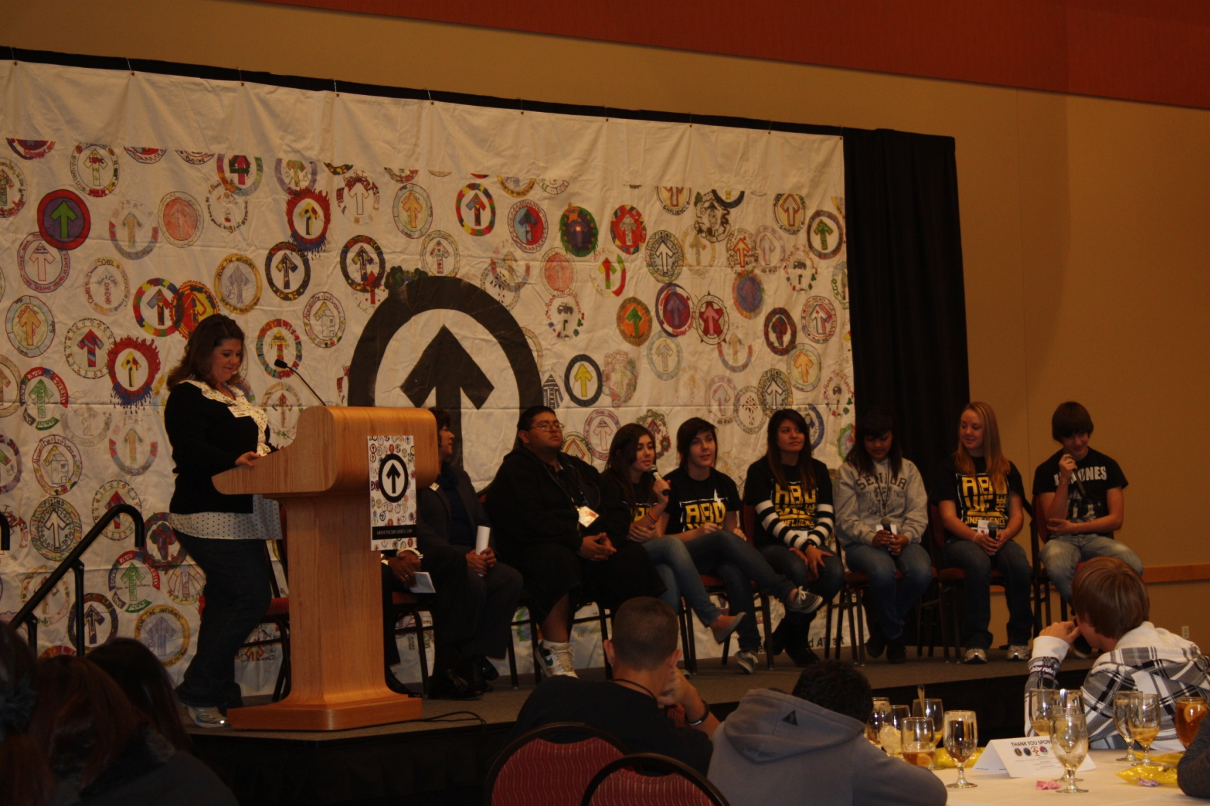
Teen Panel – Las Cruces, NM ATI Empowering Youth Conference

Slide 21
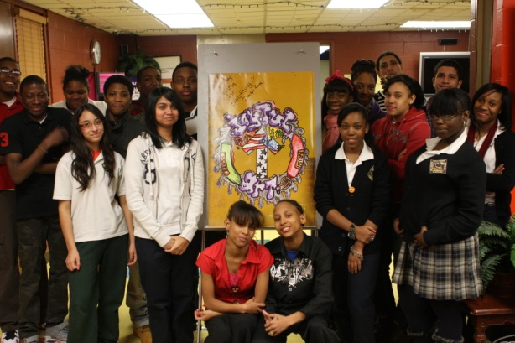
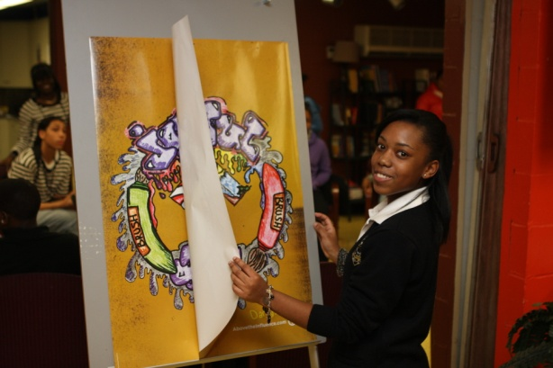
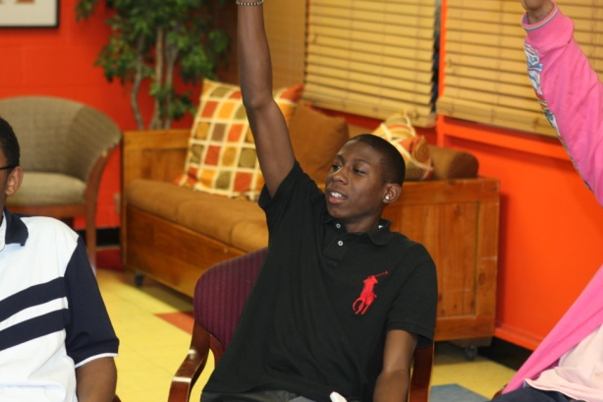
Kips Bay Boys & Girls Club (Bronx, NY)
After completing the ATI art project, Yolanda Brisbane-Baird, unit director at the Kips Bay Boys & Girls Club, challenged her youth to form their own ATI team to design ATI-themed events throughout the year:
  A Valentine’s Teen Party, where teens featured an alcohol-free teen bar. Teens who submitted their ATI artwork were admitted for $1 versus $5.
  A "Stop Bullying – Speak Up" town hall meeting sponsored by Cartoon Network and Cablevision. Youth conducted the ATI “Tag It” activity before the event and showcases their “tags” during the town hall meeting.
  A large wall display in the lobby of the club dedicated to ATI, with a new theme each month. In February, the club focused the ATI theme on diversity, love and appreciation in observance of Black History Month. In March, the Kips Bay swim team was featured on the wall with the theme: “We Swim Above the Influence."

Slide 22
Resources for Stakeholders
ATI Activities Toolkit includes:
  Influence Video Discussion Guide: Opens up a dialogue with teens about influences they face; builds “influence literacy”
  “Tag It”: Empowers teens to identify and reject negative influences
  “Be It”: Challenges teens to create their own personal positive slogans/brands in 6 words or less
  “Bring It”: Strengthens teens’ resistance skills through role playing scenarios
  ATI Art Project: Use visual/artistic expressions to convey what being “Above the Influence” means to teens
Toolkits and supporting materials: www.atipartnerships.com
www.abovetheinfluence.com and www.facebook.com/abovetheinfluence

Slide 23
ATI Resources Available
Download the ATI Toolkit: http://theantidrug.com/resources
Questions?

